Slide 1

GUI based Application Framework For Machine Learning
© Templateswise.com
A Minor Project On:
BY: Aakash Lakhangaonkar
(189301168)
Under The Guidance Of
Ms. Bali Devi

Slide 2
Contents
Table Of:
Introduction
Objective
Methodology
Pre-Existing Tools
Tech Used
Process Diagram
Progress
Gantt Chart
Future Scope
References

Slide 3
Introduction:
It is a Graphical User Interface based framework for machine learning algorithms with predictions and visualization.
It would contain built in tools for standard machine learning tasks.
It can helpful when you want output from dataset and avoid the pain of writing all the code.
It can be widely used in teaching, research and industrial applications in the field of healthcare, education, media, manufacturing industries, etc.

Slide 4
Algorithms:
Regression
Classification
Clustering
K-Neighbors
Logistic Regression
Random Forest
Naïve Bayes
SVM
K-Means
Hierarchical Clustering
Density Based Clustering
Linear Regression
Multi-Linear Regression
Non-Linear Regression

Slide 5
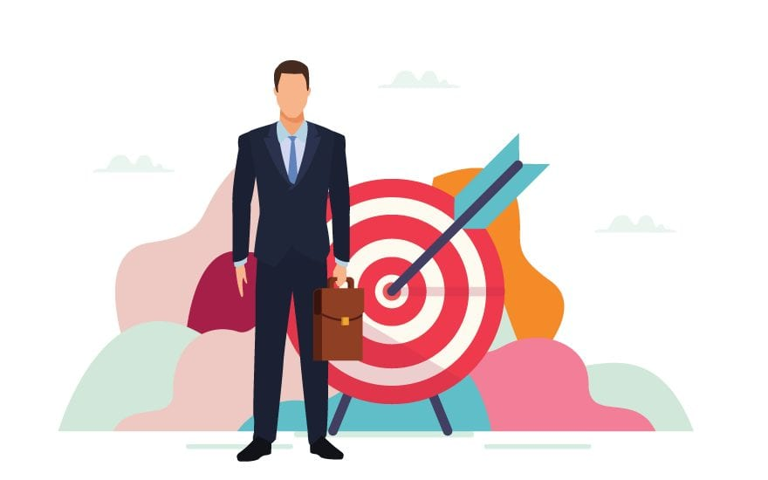
Objective:
The objective of this project is to develop a Graphical User Interface based application framework which helps users in making prediction models and visualizations for different machine learning algorithms.

Slide 6
M E T H O D O L O G Y
Research
Understanding the current drawbacks of platforms.
Data Collection And Model Training
Backend
Developing UI Front End
Documentation

Slide 7
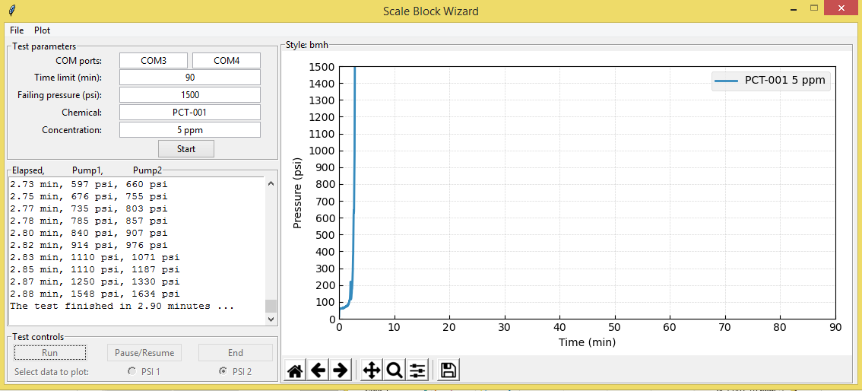
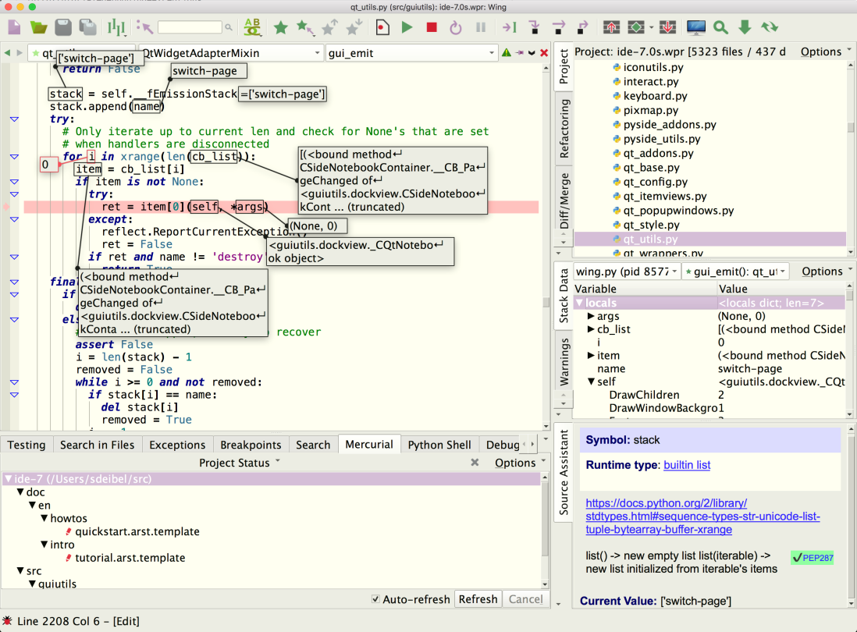
Pre-Existing Tools
WXPython
Tinkter

Slide 8
Technologies Used:
Python
Pandas
Plotly
HTML
CSS
Streamlit

Slide 9
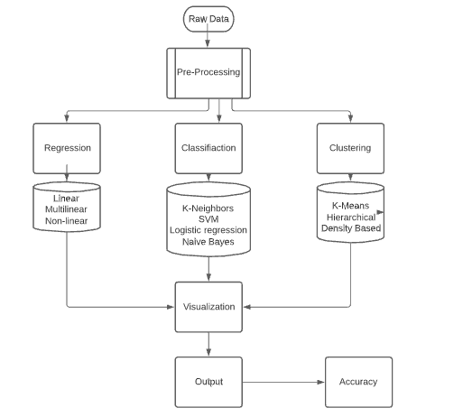
Process Diagram:

Slide 10
Progress:

Slide 11
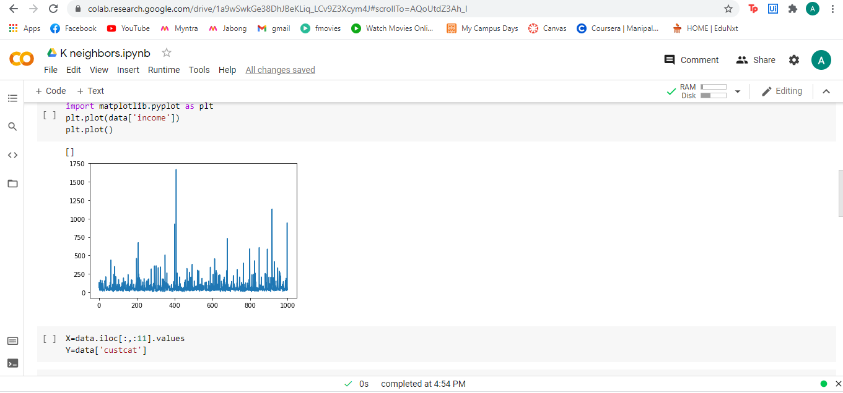
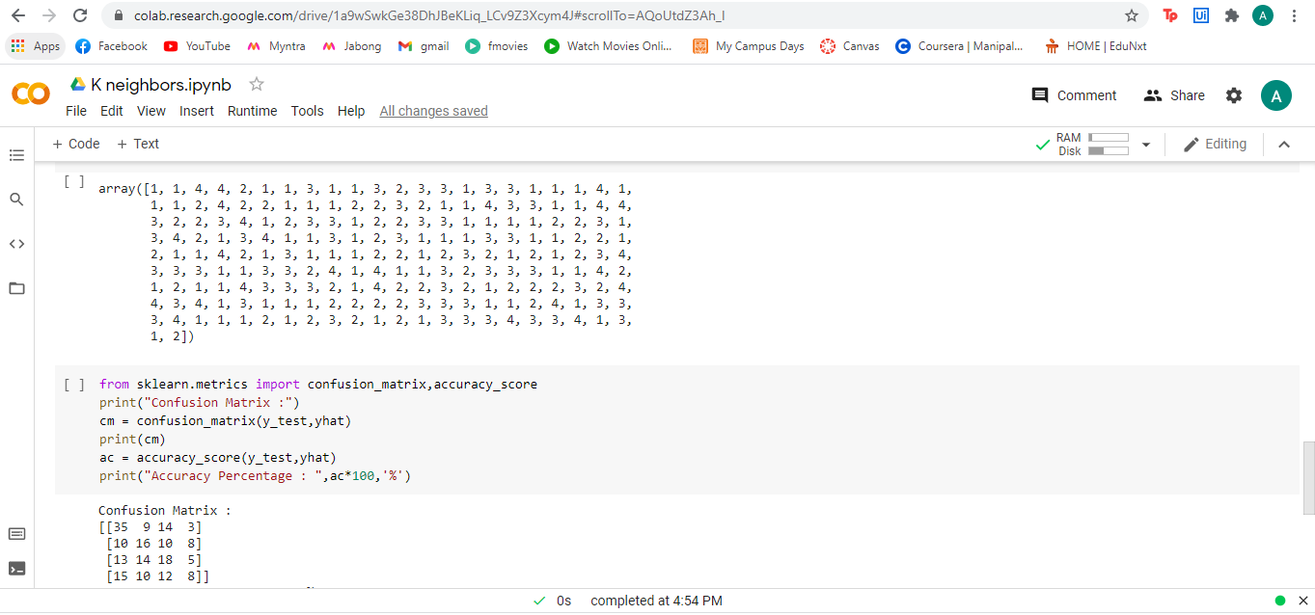
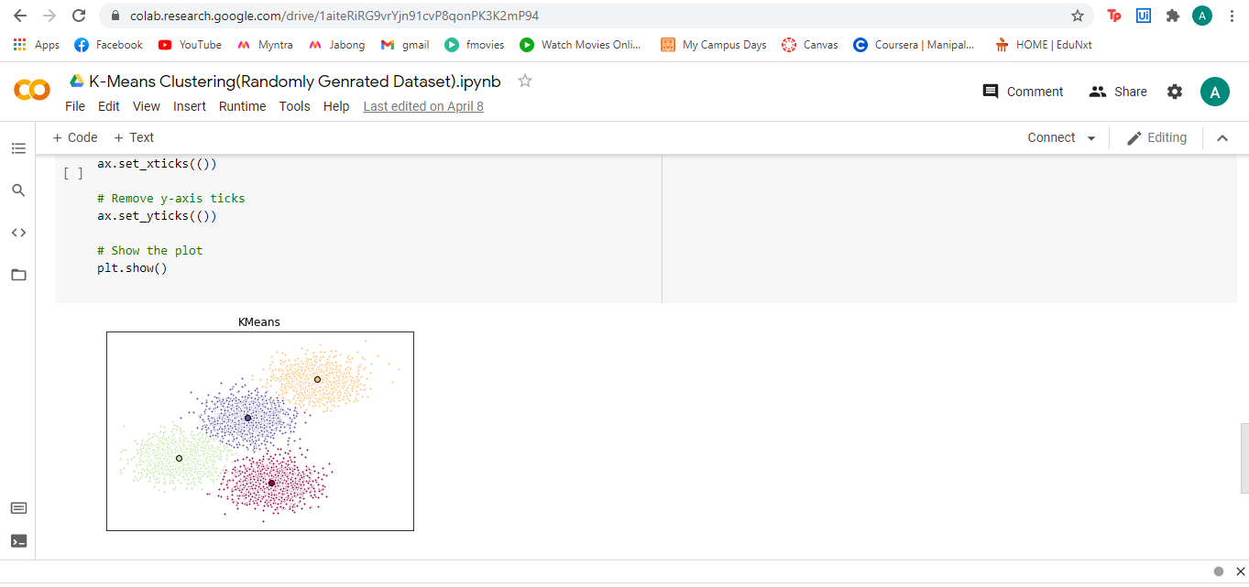
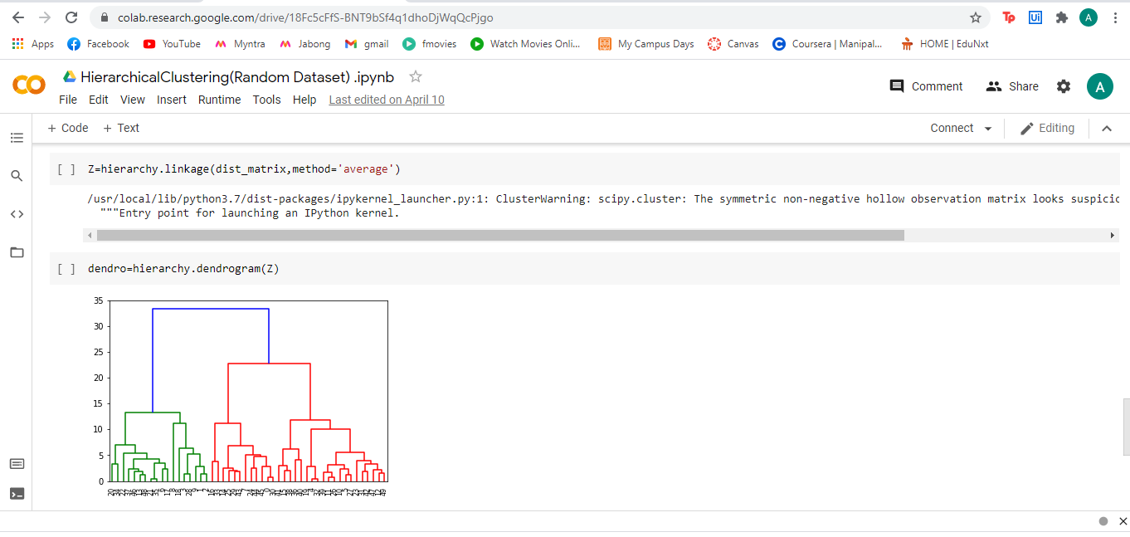

Slide 12
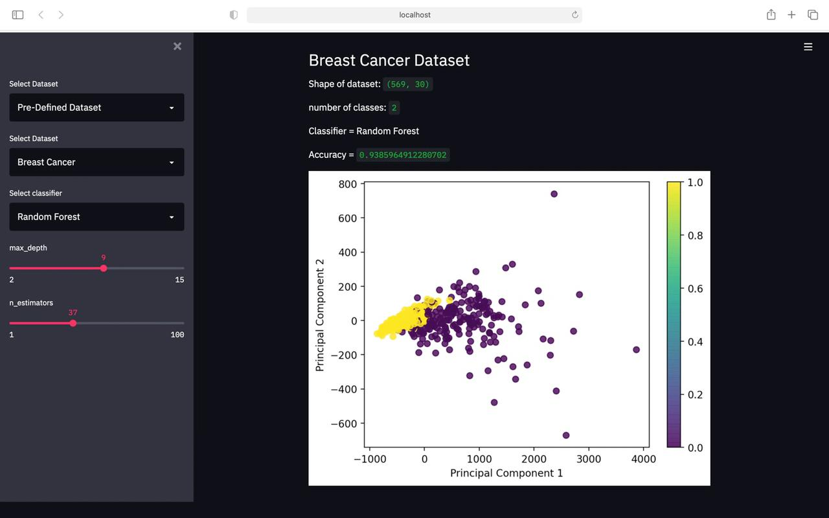
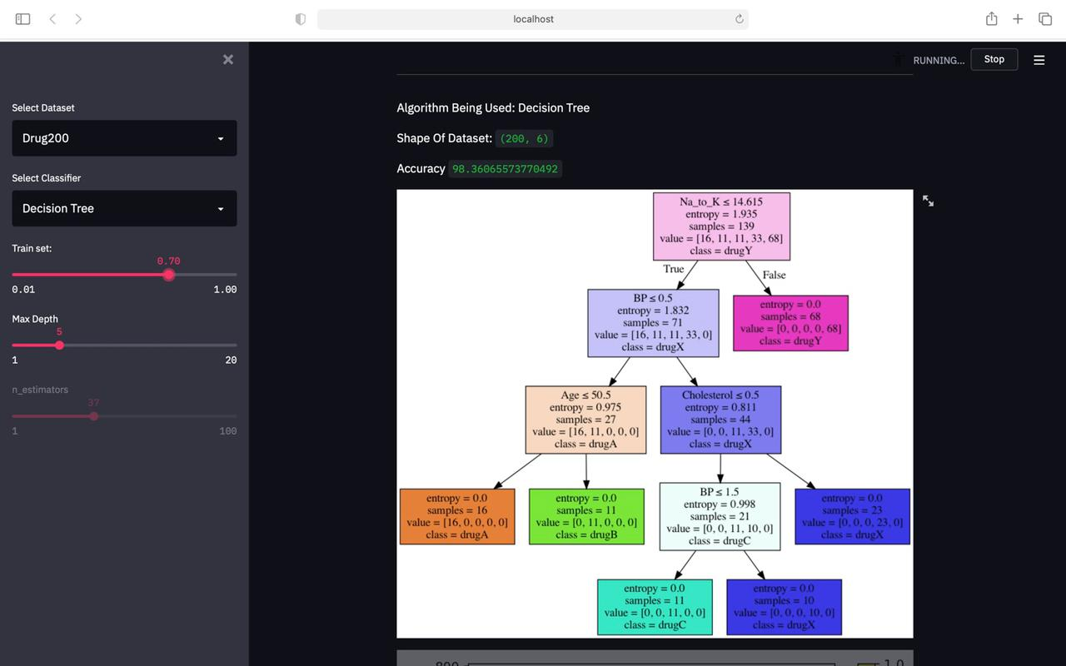
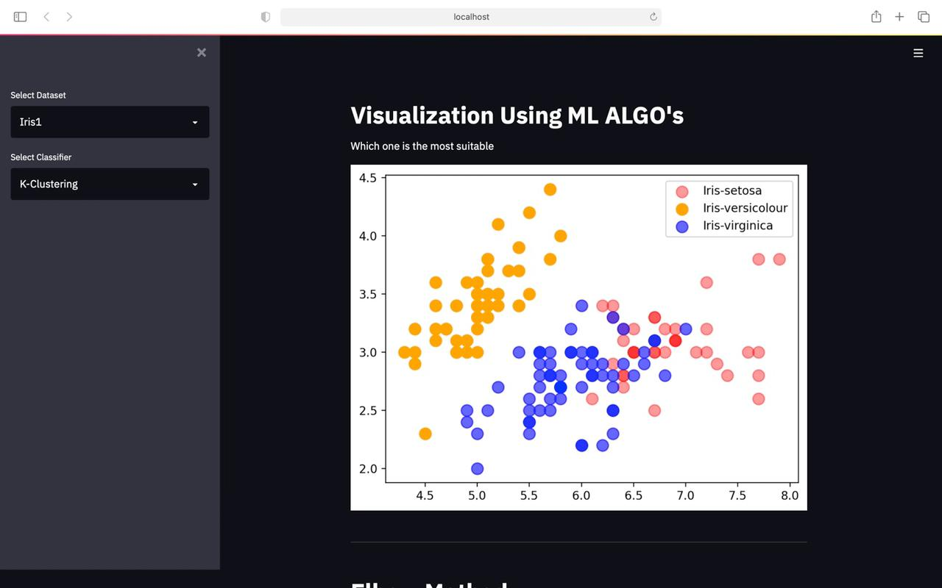
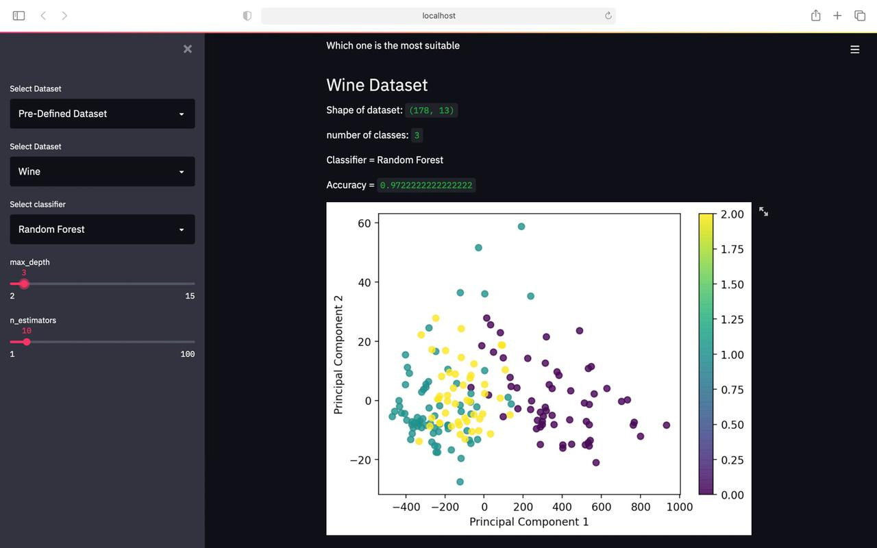

Slide 13
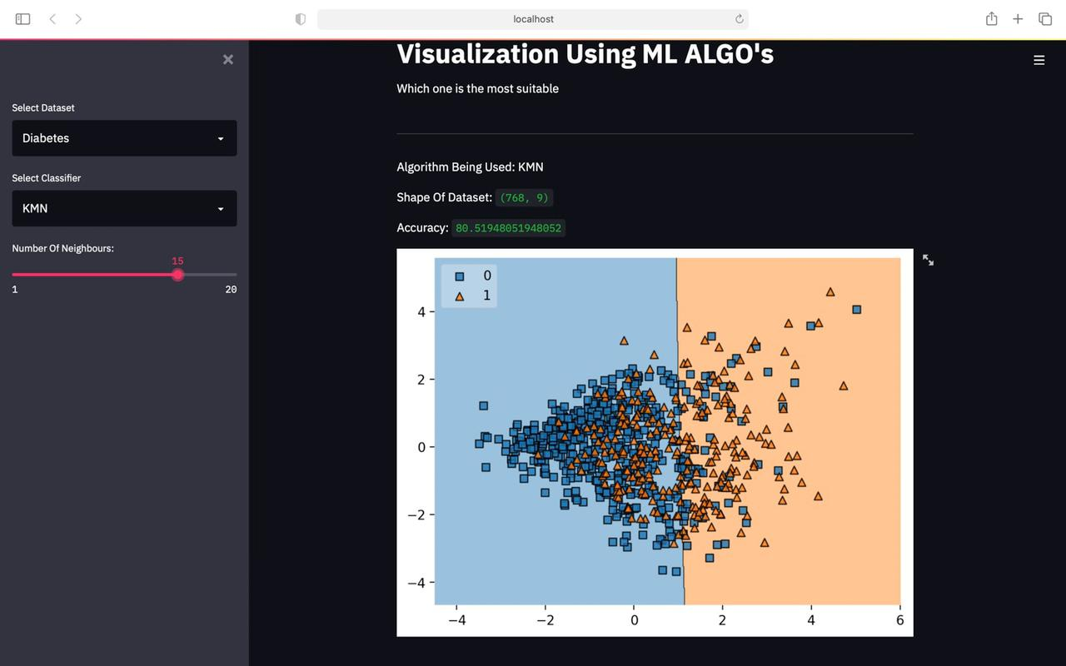
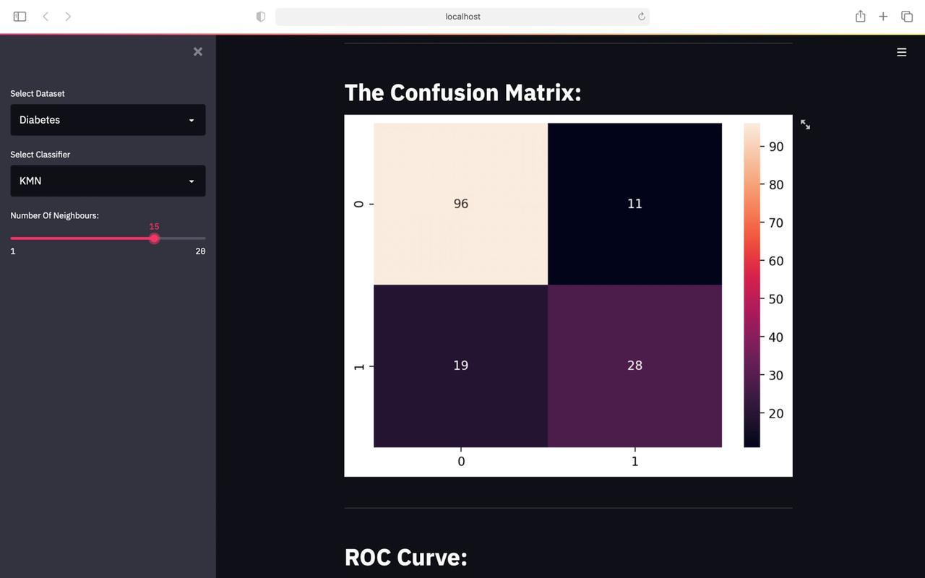
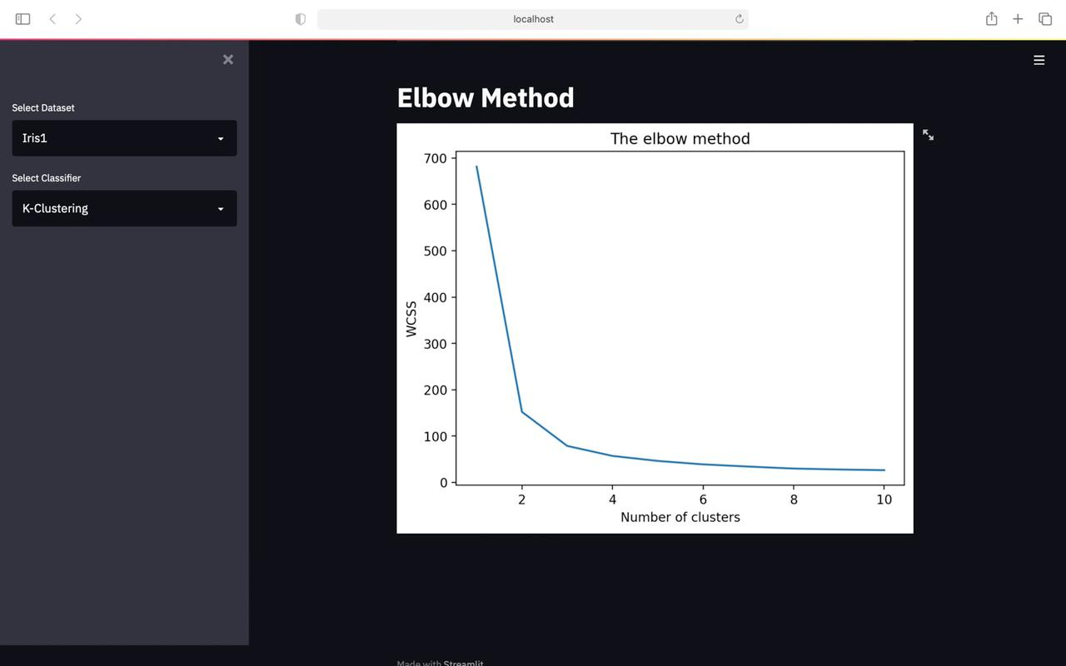
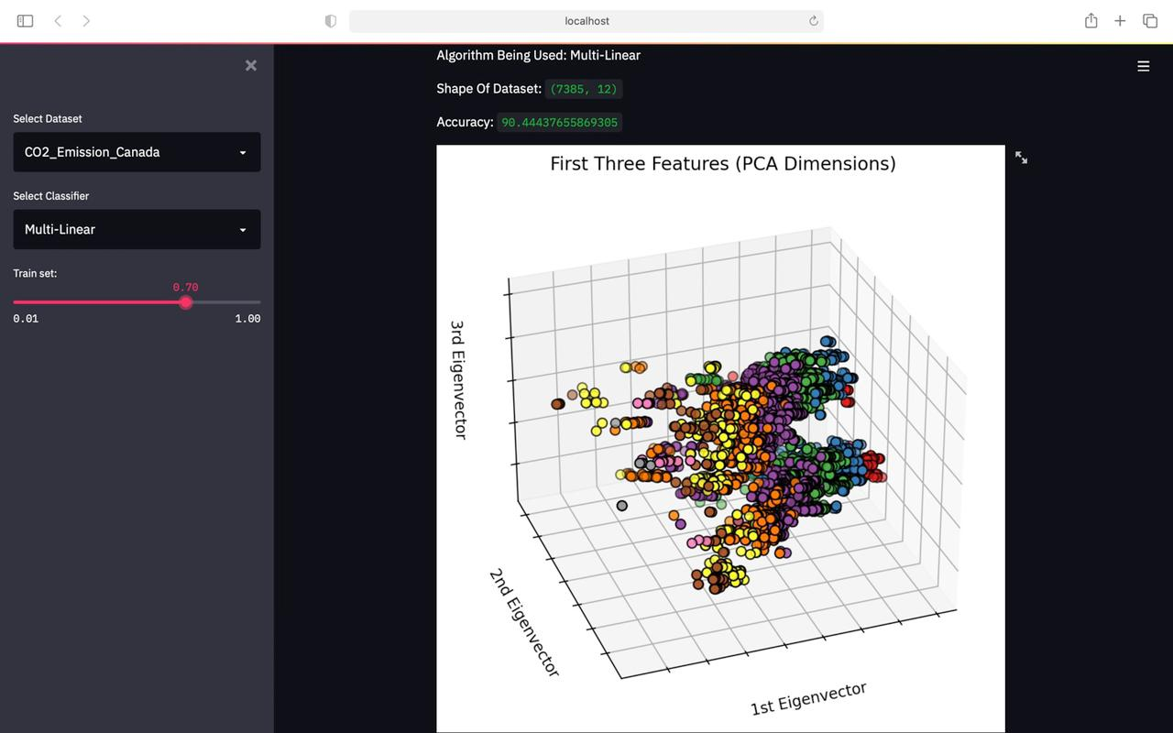

Slide 14
Gantt Chart:

Slide 15
Future Scope:
Input custom dataset
Reinforcement Learning Algorithms
Custom Feature Extraction
Better Interface
A Value Prediction Feature.

Slide 16
References:
Machine Learning With Python by IBM https://www.coursera.org/learn/machine-learning-with-python/home/welcome
machinelearningmastery.com
https://www.geeksforgeeks.org/
https://streamlit.io/
https://youtu.be/Klqn--Mu2pE
https://www.kaggle.com/

Slide 17
Thank-You

